Slide 1
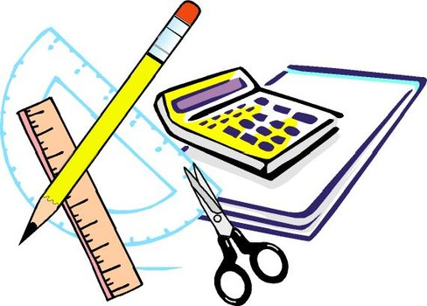
Learning Objective
I will revise probability
Enter quietly, please be ready with the following on your desk:
Whiteboard
Whiteboard marker
Exercise Book
Pencil, ruler and red pen
Scissors and glue stick
Diary
Device – charged or borrowed from Library before maths

Slide 2
PROBABILITY RECAP

Slide 3








Review
Number of successful outcomes Number of outcomes in total
$$\frac{3}{5}$$
Pr(red)
Pr(blue)
Pr(H)
Pr(M)
Pr(vowel)
Pr(consonant)
Pr(letter)
$$\frac{2}{5}$$
M A
T H E
M A T
I C S
$$\frac{1}{11}$$
$$\frac{2}{11}$$
$$\frac{4}{11}$$
$$\frac{7}{11}$$
$$\frac{11}{11}=1$$

Slide 4
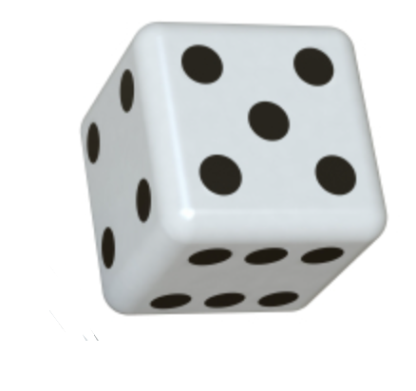









Review
Complement – the probability of something not happening.
Pr(event happening) + Pr(event not happening) = 1
Pr(rolling a 5) = $\frac{1}{6}$
Pr(not rolling a 5) = $\frac{5}{6}$
$$\frac{1}{6}+\frac{5}{6}=1$$
Pr(rolling odd) = $\frac{3}{6}$
Pr(not rolling odd) = $\frac{3}{6}$
$$\frac{3}{6}+\frac{3}{6}=1$$
Pr(rolling a cube) = $\frac{1}{6}$
Pr(not rolling a cube) = $\frac{5}{6}$
$$\frac{1}{6}+\frac{5}{6}=1$$

Slide 5
MULTIPLE EVENTS

Slide 6
Review
CFU 1
Why does this sample space have 12 different outcomes?
In some multiple events, the number of equally likely outcomes will be different for each event.
If you toss a coin (H, T) and roll a dice (1, 2, 3, 4, 5, 6), your sample space will look like this.
H1, H2, H3, H4, H5, H6, T1, T2, T3, T4, T5, T6
Number of successful outcomes Number of outcomes in total
What is the probability of getting a heads and a three?
1/12
What is the probability of getting a tails and a five?
1/12
What is the probability of getting a heads and odd?
3/12 = 1/4
What is the probability of getting a tails and less than 5?
4/12 = 1/3
What is the probability of getting a heads and 2 or more?
5/12

Slide 7
Review
Number of successful outcomes Number of outcomes in total
James loves to play football with his mates after school, but he also loves to play his guitar. He can’t decide what to do so he tosses a coin. Heads means he will play football that day, and tails means he will play the guitar.
Find the probability that over 3 days, he will:
play football 3 days in a row b) play football at least twice (2 or more)
c) play guitar 2 days in a row d) doesn’t do the same activity 2 days in a row
HHH, HHT, HTH, HTT, THH, THT, TTH, TTT
a) Pr(football 3 days) = Pr(HHH)
b) Pr(football at least twice) = Pr(HHH or HHT or HTH or THH)
= 1/8
= 4/8 = 1/2
c) Pr(guitar 2 days in a row)
= Pr(TTT or TTH or HTT)
d) Pr(alternates)
= Pr(HTH or THT)
= 3/8
= 2/8 = 1/4

Slide 8
TWO WAY TABLES AND VENN DIAGRAMS

Slide 9
Review
The following table has been drawn up to show the results of a survey on smoking.
 | Smokers | Nonsmokers
Male | 48 | 64
Female | 38 | 122
How many people were surveyed?
48 + 64 + 38 + 122 = 272
How many females were surveyed?
38 + 122 = 160
How many of the people surveyed were smokers?
48 + 38 = 86
What is the probability females were smokers?
38/160 = 19/80
If a person is selected at random from the group, what is the probability that they are a male smoker?
48/272 = 3/17

Slide 10
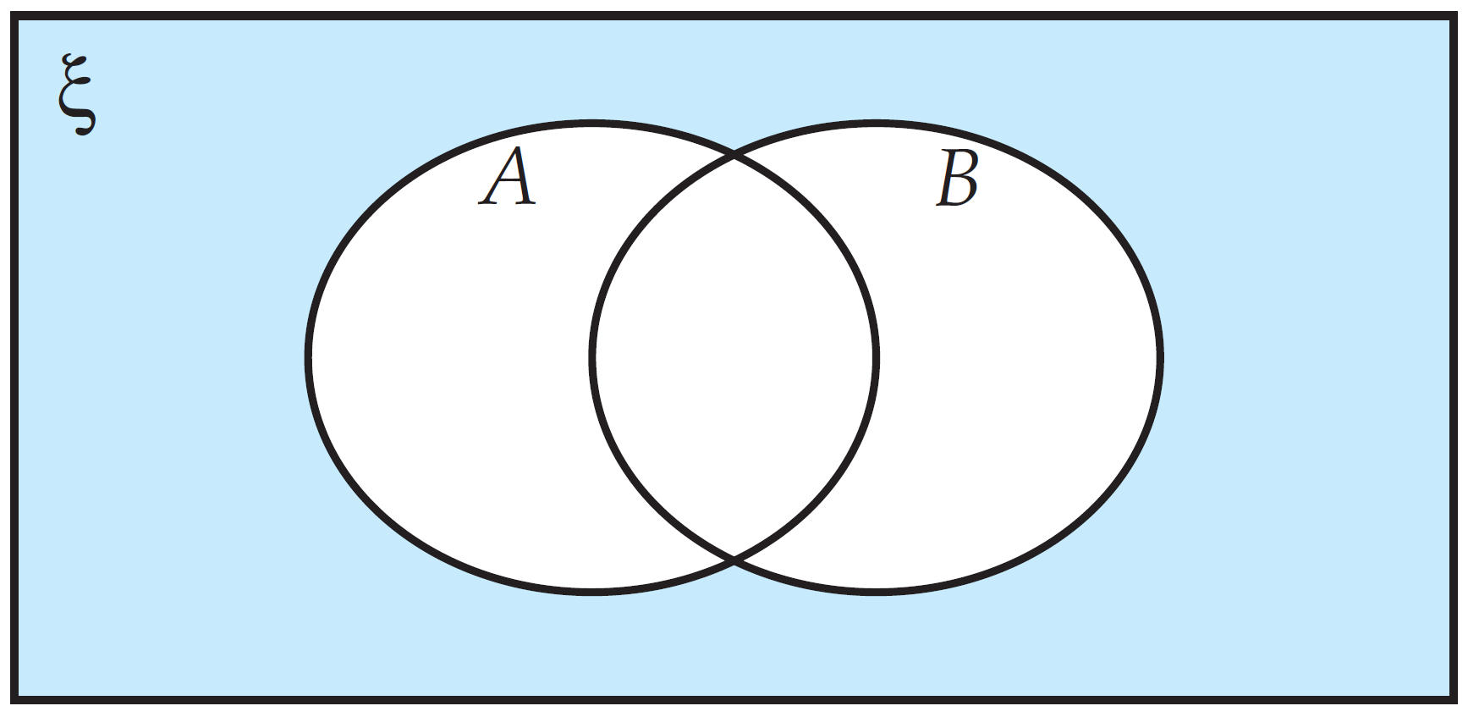
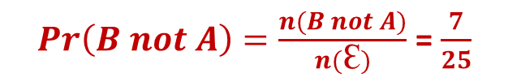
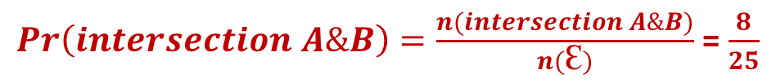
Review
25 students all enjoy watching basketball (A), tennis (B) or basketball and tennis. 18 enjoy watching basketball and 15 enjoy watching tennis.
What is the probability that a student selected at random would:
Enjoy watching basketball and tennis?
b) Only enjoy watching tennis?
$Pr\left(intersection A\&B\right)=\frac{n(intersection A\&B)}{n(Ꜫ)}$ = $\frac{8}{25}$
18 + 15 = 33
Overlap
$Pr\left(B not A\right)=\frac{n(B not A)}{n(Ꜫ)}$ = $\frac{7}{25}$
33 – 25 = 8

Slide 11
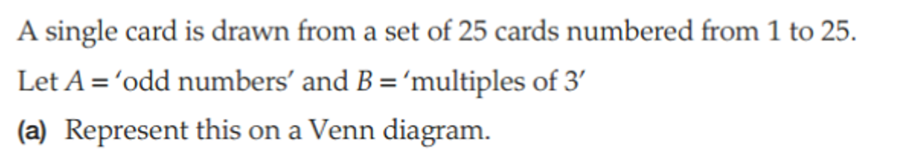
Review

Slide 12
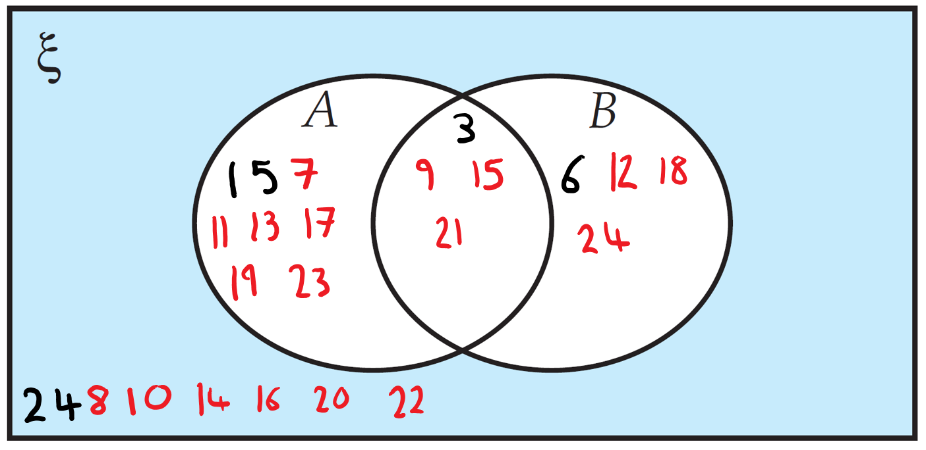
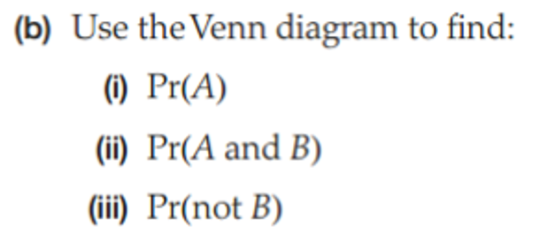



Review
$$\frac{9+4}{25}=\frac{13}{25}$$
$$\frac{4}{25}$$
$$1−\frac{8}{25}=\frac{17}{25}$$

Slide 13
Review
 | B | Not B
A
Not A
4/25
9/25
13/25
4/25
8/25
8/25

Slide 14
MUTUALLY EXCLUSIVE AND INDEPENDENT AND DEPENDENT EVENTS

Slide 15

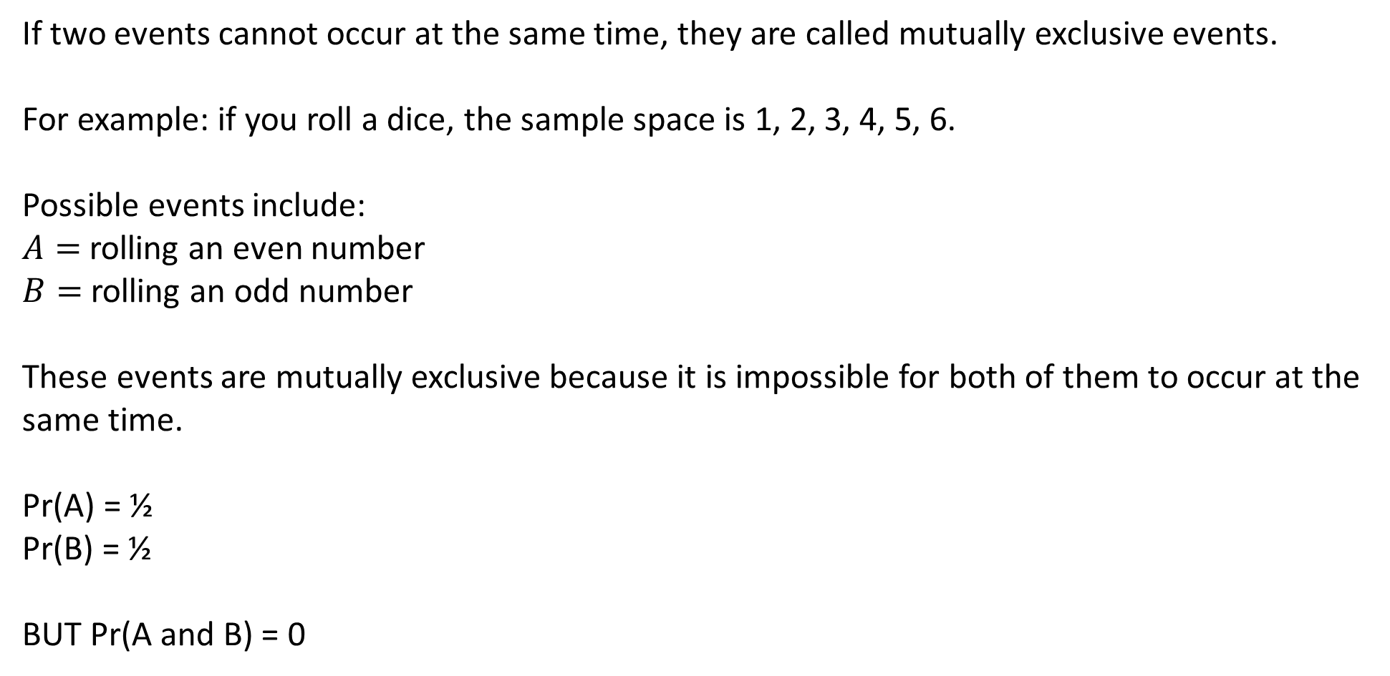
Review
CFU 1
What are mutually exclusive events?
If two events cannot occur at the same time, they are called mutually exclusive events.
For example: if you roll a dice, the sample space is 1, 2, 3, 4, 5, 6.
Possible events include:
$A=$rolling an even number
$B=$rolling an odd number
These events are mutually exclusive because it is impossible for both of them to occur at the same time.
Pr(A) = ½
Pr(B) = ½
BUT Pr(A and B) = 0

Slide 16
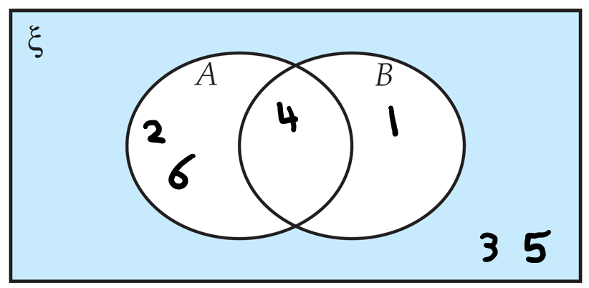
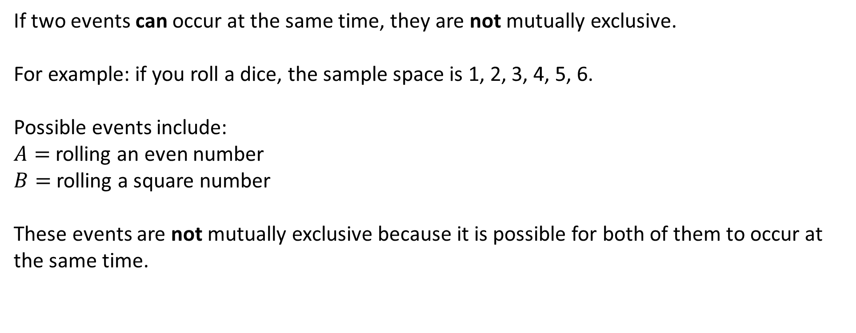
Review
CFU 1
What are mutually exclusive events?
If two events can occur at the same time, they are not mutually exclusive.
For example: if you roll a dice, the sample space is 1, 2, 3, 4, 5, 6.
Possible events include:
$A=$rolling an even number
$B=$rolling a square number
These events are not mutually exclusive because it is possible for both of them to occur at the same time.
4 is both an even number and a square number, so A and B can occur at the same time.

Slide 17
Review
If two events cannot occur at the same time, they are called mutually exclusive events.
If two events can occur at the same time, they are not mutually exclusive.
Decide whether the following events are mutually exclusive or not.
Tossing a coin and getting a heads and tossing a coin and getting a tails.
ME
Winning a football game and losing the same football game.
ME
ME
Picking a red card from a deck of cards and picking a black card from a deck of cards.
Not ME
Picking a red card from a deck of cards and picking a Jack, Queen or King.
ME
Catching a bus and missing the same bus.
Not ME
Watching a comedy movie and watching a romantic movie.
Not ME
Rolling the number 2 on a dice and rolling a number less than 4 on a dice.
A traffic light being red and a traffic light being green.
ME
Not ME
A traffic light being red and the pedestrian crossing being green.

Slide 18
Review
$\left(A∩B\right)$: A and B
Independent Events:
Events where the outcome of one event has no effect on the outcomes of the other
If A and B are independent events, $P\left(A∩B\right)=P(A)×P(B)$
Dependent Events:
Events where the outcome of one event does have an effect on the outcome of the other
If A and B are dependent events and A occurs first, $P\left(A∩B\right)=P(A)×P(B, once A has occurred)$

Slide 19
Review
$\left(tail ∩ 1\right)$ = $tail and 1$
Consider the situation where you spin a spinner with outcomes 1, 2 and 3, and toss a coin.
Represent the information in a two-way tables
Probability of getting a Tail
Probability of spinning a 1
Determine P(tail) x P(1)
Probability of tossing a tail and spinning a 1
b) $P\left(tail\right)=\frac{1}{2}$
c) $P\left(spinning 1\right)=\frac{1}{3}$
d) $P\left(tail\right)×P\left(1\right)=\frac{1}{2}×\frac{1}{3}=\frac{1}{6}$
e) $P\left(tail ∩ 1\right)=\frac{1}{6}$
Notice: $P\left(tail ∩ 1\right)=P(tail)×P(1)$
Tossing a Tail and Spinning a 1 are independent events

Slide 20


Review
On a desk, there sits a container of 5 black and 5 blue pencils, and a second container with 20 coloured pencils. The coloured pencils include 2 red, 4 purple, 3 green and 11 yellow.
What is the probability of selecting a black pencil from the first container?
What is the probability of selecting a red pencil from the second container?
Does the probability of selecting the black pencil affects the probability of selecting the red pencil?
Are the events independent or dependent? Why?
a) $P\left(black\right)=\frac{1}{2}$
b) $P\left(red\right)=\frac{2}{20}=\frac{1}{10}$
c) No
d) Independent. The outcomes of one event does not affect the outcome of the other

Slide 21
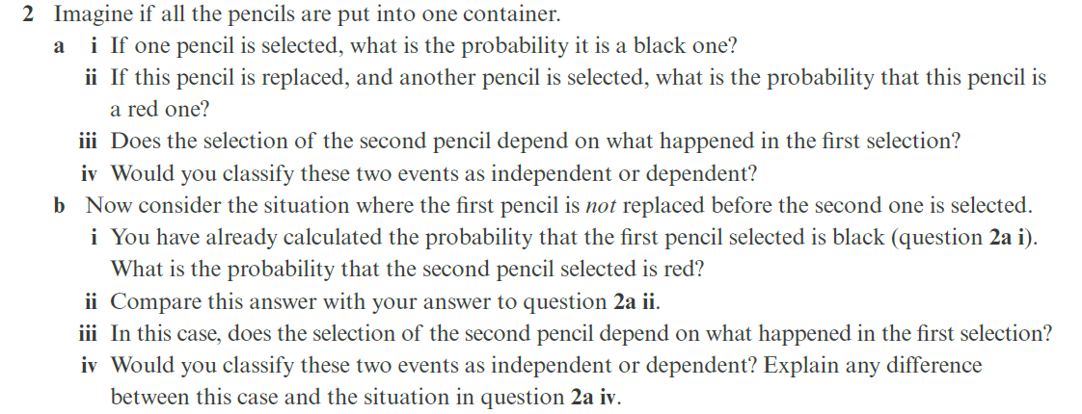
Review
We now combine all the pencils into one container. There are now 5 black, 5 blue pencils, 2 red, 4 purple, 3 green and 11 yellow pencils
What is the probability of selecting a black pencil?
If this pencil is replaced, and another pencil is selected, what is the probability that this pencil is a red one?
Does the selection of the second pencil depend on what happened in the first selection?
Would you classify these two events as independent or dependent?
a) $P\left(Black\right)=\frac{5}{30}=\frac{1}{6}$
b) $P\left(red\right)=\frac{2}{30}=\frac{1}{15}$
c) No
d) Independent.

Slide 22
Review
Now consider the situation where the first pencil is not replaced before the second is selected.
What is the probability of selecting a black pencil?
Another pencil is selected, what is the probability that this pencil is a red one?
Does the selection of the second pencil depend on what happened in the first selection?
Would you classify these two events as independent or dependent? Why?
a) $P\left(Black\right)=\frac{5}{30}=\frac{1}{6}$
b) $P\left(red\right)=\frac{2}{29}$
c) Yes
d) Dependent because the second event outcome is dependent on the first.

Slide 23
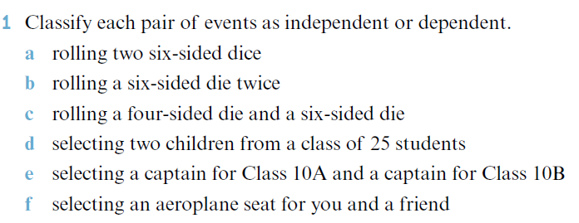
Review
Independent
Independent
Independent
Dependent
Independent
Dependent

Slide 24
TREE DIAGRAMS

Slide 25
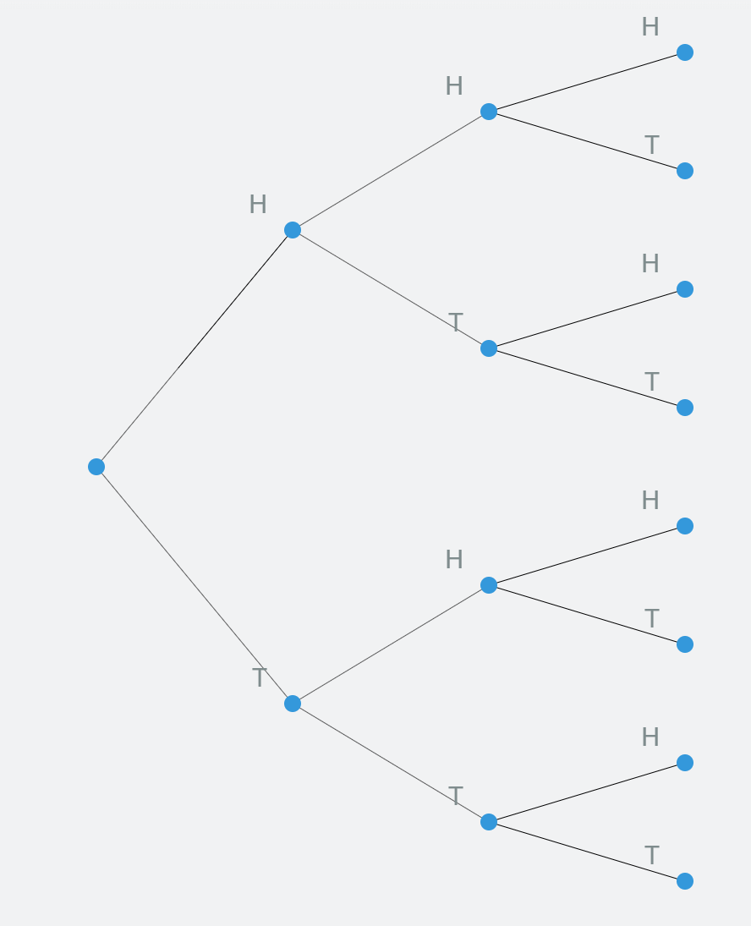
Review
What is the probability of getting:
1/8
Three heads?

Slide 26
Review
What is the probability of getting:
1/8
Three heads?
1/8
Three tails?

Slide 27
Review
What is the probability of getting:
1/8
Three heads?
1/8
Three tails?
1/8
No tails?

Slide 28
Review
What is the probability of getting:
1/8
Three heads?
1/8
Three tails?
1/8
No tails?
Exactly one tail?
3/8

Slide 29
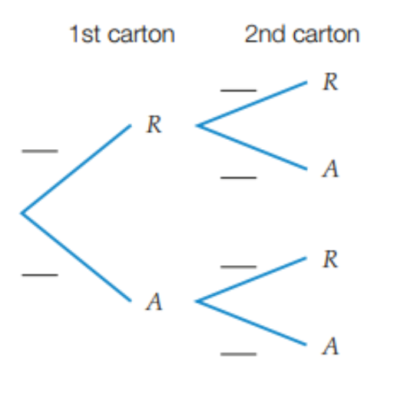
Review
At Coles, cartons of eggs are inspected for broken shells before they are put on the shelves. The probability a carton of eggs is rejected is 1/10. Two cartons of eggs are inspected.
Draw a tree diagram that represents this situation (use R for rejected and A for accepted).
Find the probability that both cartons are rejected.
Find the probability that one carton is rejected.
There are four outcomes.
b) The probability that both cartons are rejected is
Pr(RR) = 1/100.
1/10
Pr(RR) = 1/10 x 1/10 = 1/100
1/10
9/10
Pr(RA) = 1/10 x 9/10 = 9/100
c) The probability that one carton is rejected is Pr(RA) + Pr(AR)
= 9/100 + 9/100
= 18/100 = 9/50
9/10
1/10
Pr(AR) = 9/10 x 1/10 = 9/100
9/10
Pr(AA) = 9/10 x 9/10 = 81/100

Slide 30
Review
A marble is taken from a bag containing 4 blue marbles and 7 green marbles. It is not replaced before a 2nd marble is taken out.
a) Draw a tree diagram that represents this situation.
b) Find the probability of getting two green marbles.
c) Find the probability of getting at least one blue marble.
‘without replacement’
<
1st
2nd
b) The probability of 2 greens is
Pr(GG) = 21/55
<
B
3/10
Pr(BB) = 4/11 x 3/10 = 6/55
4/11
B
<
G
7/10
Pr(BG) = 4/11 x 7/10 = 14/55
B
c) The probability of at least 1 blue is
Pr(BB) + Pr(BG) + Pr(GB)
= 6/55 + 14/55 + 14/55
= 34/55
4/10
Pr(GB) = 7/11 x 4/10 = 14/55
7/11
G
6/10
G
Pr(GG) = 7/11 x 6/10 = 21/55

Slide 31
CONDITIONAL STATEMENTS

Slide 32



Review
 | Year 7 | Year 8 | Year 9 | TOTAL
Boys | 9 | 8 | 12 | 29
Girls | 4 | 10 | 7 | 21
TOTAL | 13 | 18 | 19 | 50
Given a boy is selected, what is the probability of that they are in Year 8?
Pr(Year 8 if boy) =
Given a girl is selected, what is the probability that they are in Year 9?
Pr(Year 9 if girl) =
Given a Year 9 pupil is selected, what is the probability that they are a boy?
Pr(boy if Year 9) =
$$\frac{8}{29}$$
 | Year 7 | Year 8 | Year 9 | TOTAL
Boys | 9 | 8 | 12 | 29
Girls | 4 | 10 | 7 | 21
TOTAL | 13 | 18 | 19 | 50
$$\frac{7}{21}$$
 | Year 7 | Year 8 | Year 9 | TOTAL
Boys | 9 | 8 | 12 | 29
Girls | 4 | 10 | 7 | 21
TOTAL | 13 | 18 | 19 | 50
$$\frac{12}{19}$$

Slide 33
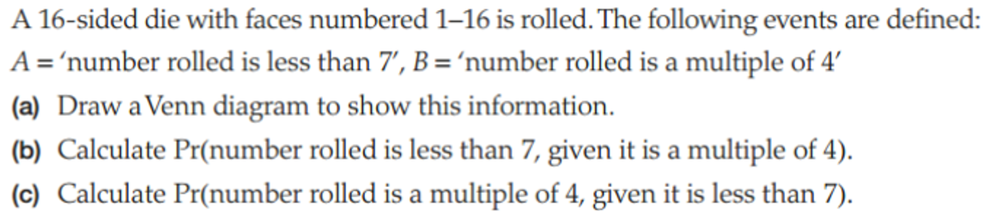
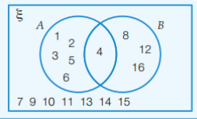
Review
b) How many outcomes are in B?
How many outcomes are in B and also A?
Pr(A, given B) =
4
1
1/4
c) How many outcomes are in A?
How many outcomes are in A and also B?
Pr(B, given A) =
6
1
1/6

Slide 34
Independent Practice
Mathspace – Year 10 Mainstream Probability Revision

